Slide 1

Airbnb Machine Learning
Daniel Parmet
5.11.2019

Slide 2
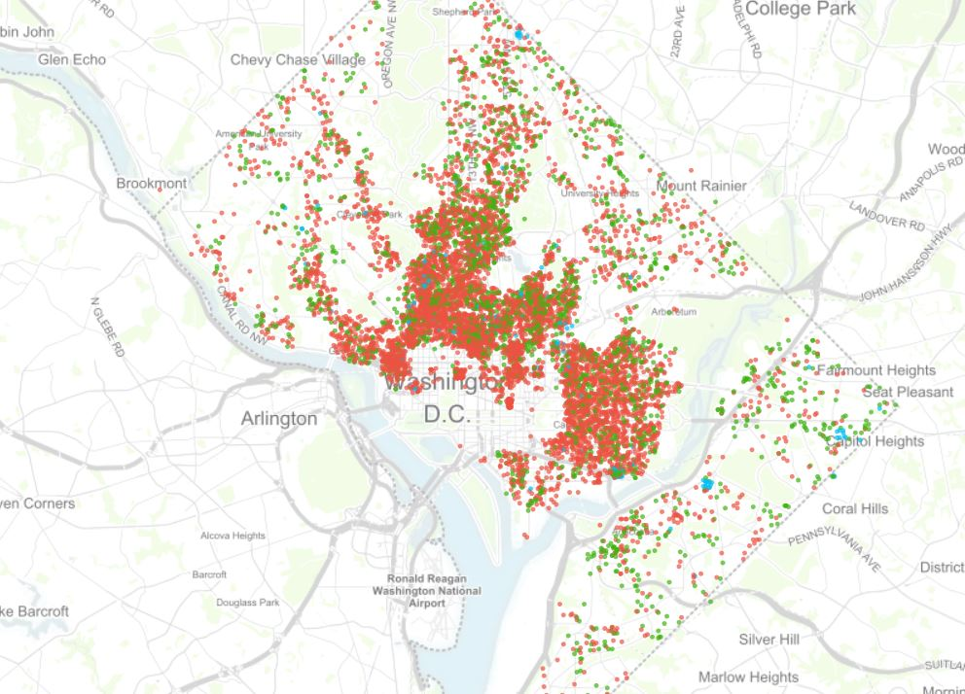
Project Summary
My goal is to test various machine learning models on a Kaggle DC dataset to see:
Correctly predict price with Machine Learning.
Find reasonable price segmentation among the offerings.
Identify areas where more revenue could be generated by hosts and Airbnb
Stretch goal: Web scrape a 2019 data set (or use someone else’s code) to compare the models built to use 2015 data vs. 2019 data.

Slide 3
Project Hypothesis
My hypothesis is that Airbnb’s own price recommendation algorithm in use in 2015 was weak.
See more over and underpriced options done by hosts.
Find opportunities to present price segmentation.
Expect fairly poor predictions from any Machine Learning due to the lack of photos and reviews which likely drive price the most.

Slide 4
Steps To The Project
EDA (Exploratory Data Analysis):
Looked at initial Data
Cleaned Data (NAN)
Created a golden database for initial tests
Initial tests around correlation
Initial ML done to get a pulse.
Advancing the ML:
Refactored code
Headed to find sources from Airbnb founders and data science team to think about the data differently
Dropped outliers
Split on entire home vs room
Created several variables for testing

Slide 5
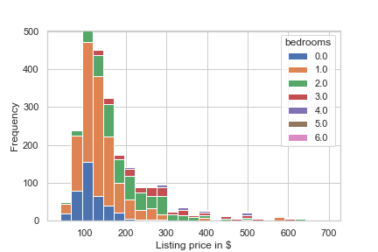
A Few Visuals

Slide 6
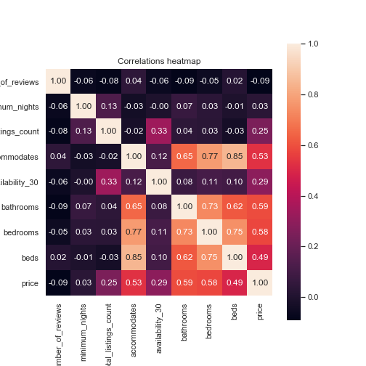

Slide 7
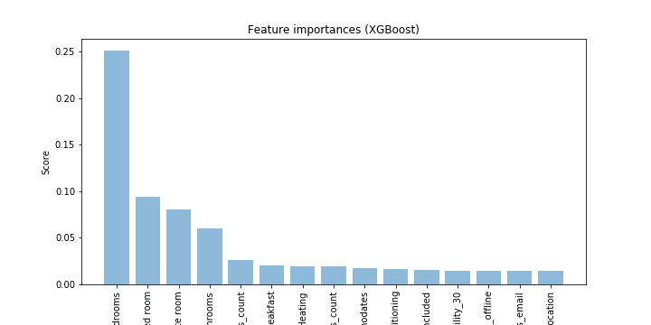

Slide 8
My Results…
Test | Model | Radj | Error
44 | XGBoost (100) | 0.755 | 41.73
42 | Random Forest (2000) | 0.647 | 52.33
41 | Linear Regression | 0.620 | 53.25
45 | Lasso (a.01) | 0.616 | 49.60
47 | Ridge (a.01) | 0.616 | 49.62
48 | Ridge (a.05) | 0.616 | 49.64
46 | Lasso (a.05) | 0.616 | 49.65
49 | ElasticNet (a.01) | 0.582 | 51.78
50 | ElasticNet (a.05) | 0.568 | 52.61
43 | Random Forest (2000) | 0.563 | 61.39
33 | Random Forest (2000) | 0.553 | 39.33
25 | Random Forest (2000) | 0.552 | 39.35
21 | Random Forest (2000) | 0.514 | 64.72
27 | Random Forest (2000) | 0.514 | 64.72
1 | Linear Regression | 0.326 | 134.65

Slide 9
Conclusions
This dataset was the DC area.
Minimum nights apparently has nothing to do with price.
There is definitely a chance to segment along entire homes versus rooms.
Superhost seems to matter and is worth testing more.
Host response time is important
Cancellation policy strictness is directly opposite correlated to price. The stricter the policy the less you can charge.

Slide 10
Next Time
What I would do differently:
Test PCA (Principal Component Analysis).
Use a more modern dataset from http://insideairbnb.com/.
If I had used insiderairbnb data, I would have had more robust data like: reviews, calendars which allows me to set for cleanliness data and other factors hosts get rated on.
There is a definite opportunity to do NLP on reviews to see how better or worse reviews drive more price.
I would add more visualizations (time restrictions, short project).
Airbnb's own conclusions 10 years ago were not surprising: PHOTOS PHOTOS PHOTOS. I would attempt to build an image classifier to see what results might be based on listings' photos.
Deeper exploration into room rentals.
This dataset was solely DC and one day. It would be nice to explore other cities to see how much that matters as city contributed nothing as a variable.
A high error term which is concerning.

